Slide 2
Xamarin.Essentials: Core Cross-Platform APIs
Presenter Name

Slide 3
Questions for you!
Notes:
Before we get started I have a few questions for existing Xamarin developers in the room.

Slide 4
How many platform APIs does your app need?
1
5
10
Too many to count
Notes:
Such as accessing geolocation or the camera?

Slide 5
How many interfaces to access native APIs?
1
5
10
Too many to count
Notes:
If you have existing apps you may have implemented a lot of these yourself.

Slide 6
How many plugins are you using?
1
5
10
What are plugins
Notes:
There are a lot of community efforts to abstract these APIs. Have you used any of these? If so how many and how was your support and getting bugs fixed? Also were the APIs consistent?

Slide 7
Overview: Xamarin.Essentials

Slide 8

.NET Mobile Development with Xamarin
iOS C#
Android C#
Windows C#
Shared Native User Interface
Shared C# Business Logic
Shared C# codebase • 100% native API access • High performance
Notes:
Let’s start with the basics of Xamarin.
You can craft fully native iOS/Android/Windows apps all in C#
Share your business logic and potentially all or some of the user i

Slide 9
Geolocation
Geolocation
Geolocation
Shared C# Backend
Compass
Compass
Compass
Keystore
Keystore
Keystore
Notes:
When you think about architecting your apps you have a bulk of shared code, but still need to get to the native APIs which you can access in C#

Slide 10
Preferences.Get(“my_key”, 0);
NSUserDefaults
SharedPreferences
ApplicationData
Notes:
Here is an example of getting preferences from shared code:
First you create an interface. In this case 1 method for Get.
Then learn 3 APIs for iOS/Android/Windows and implement the interface in C#.

Slide 11
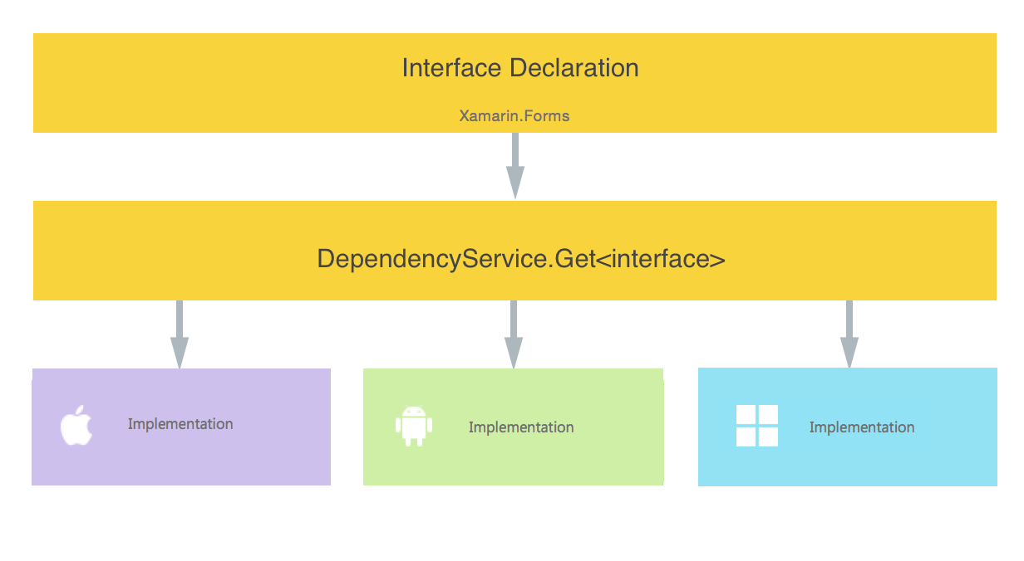
Access via Dependency Service
Notes:
Then we have to worry about how to access these:
Use some sort of Dependency Service to get the interface or optionally an IoC container
This can add bloat and slowdown of an app
If we use a community plugin we may also have to do this or worry about different setup on each platform

Slide 12
Issues
Must Learn Multiple APIs
Interface Overhead
Maintainability across multiple platforms
Additional Assembly Overhead
Notes:
So while it is awesome that we have access to everything with Xamarin when we want to access those features we run into a few walls.

Slide 13
Core Cross-Platform APIs
Notes:
Don’t worry though because the Xamarin team at Microsoft has us covered!

Slide 14

Xamarin.Essentials
Secure Settings
Sms
Preferences
Flashlight
Clipboard
Gyroscope
Magnetometer
Geolocation
Phone Dialer
Device Display Info
Email
Device Info
Battery
Compass
Accelerometer
Screen Lock
Data Transfer
Text to Speech
Geocoding
File System
Connectivity
Vibration
aka.ms/xamarinessentials
Notes:
Xamarin.Essentials offers a single library to access native APIs from shared code. As of today it features over 30 different APIs that are super optimized for each platform and deliver a consistent API experience.
Here is a sample of some of them.

Slide 15
Official Platform Support
Android 4.4+ (API 19)
iOS 10+
UWP: Fall Creators Update
Xamarin.iOS, Xamarin.Android, UWP, and Xamarin.Forms
Notes:
Xamarin.Essentials works with any application no matter how you are building the user interface or if it is just a single application.
It support these versions of the OS, which account for over 95% of all users.

Slide 16
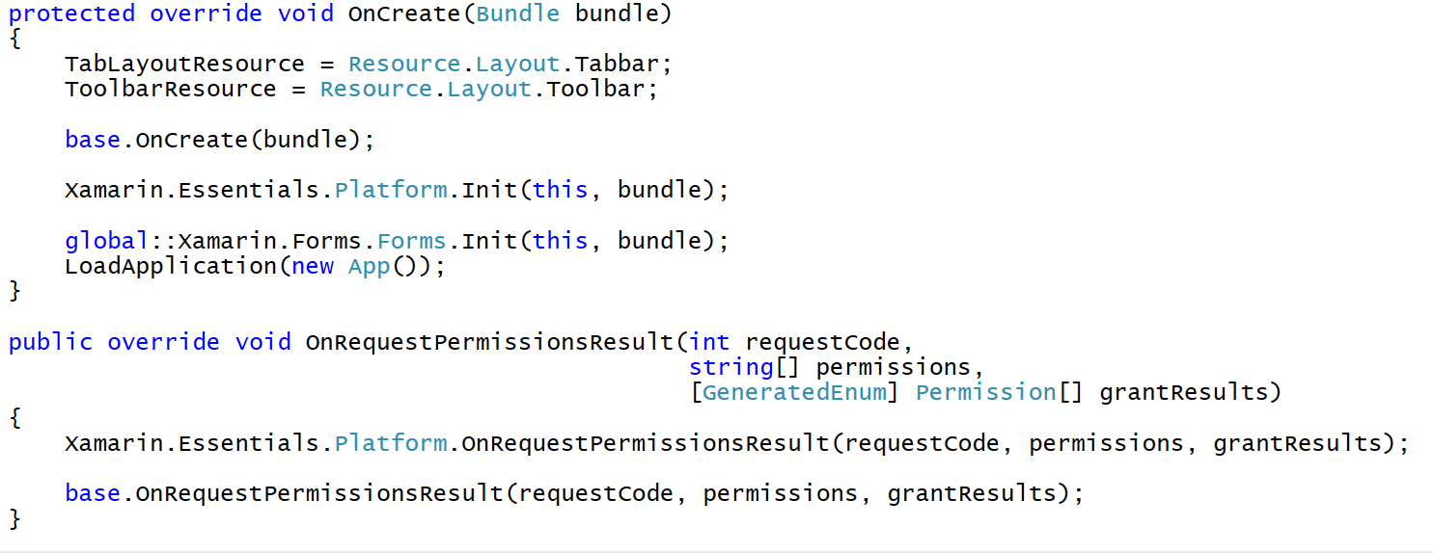
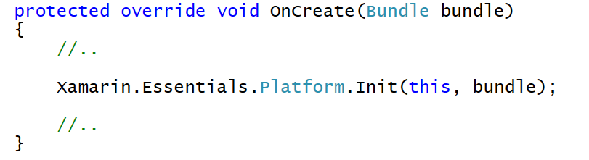
Get Started
NuGet – Xamarin.Essentials
Android Setup:
Notes:
It is really easy to get started. A single NuGet gets installed into your project.
For Android there is just a small bit of setup that needs to go in to track the activity state and handle permissions.

Slide 17
Super Optimized
Fully Linker Safe using [LinkerSafe] Attributes
Linking Always Happens
Link SDK Assemblies and Link All Assemblies
Case Study: GeoContacts App
Before:
Assemblies: 47
APK Size: 22.7 MB
After:
Assemblies: 35
APK Size: 22.2 MB
Notes:
I mentioned it was super optimized, and that is because it is “Linker Safe”
Here is a case study of an app that used about 6 different plugins and what it looked like after switching over to Xamarin.Essentials

Slide 18
Demo
Xamarin.Essentials

Slide 19
Resources
Xamarin.Essentials
Docs: aka.ms/xamarinessentials
GitHub: github.com/Xamarin/Essentials
Compass
github.com/jamesmontemagno/app-compass

